Slide 1
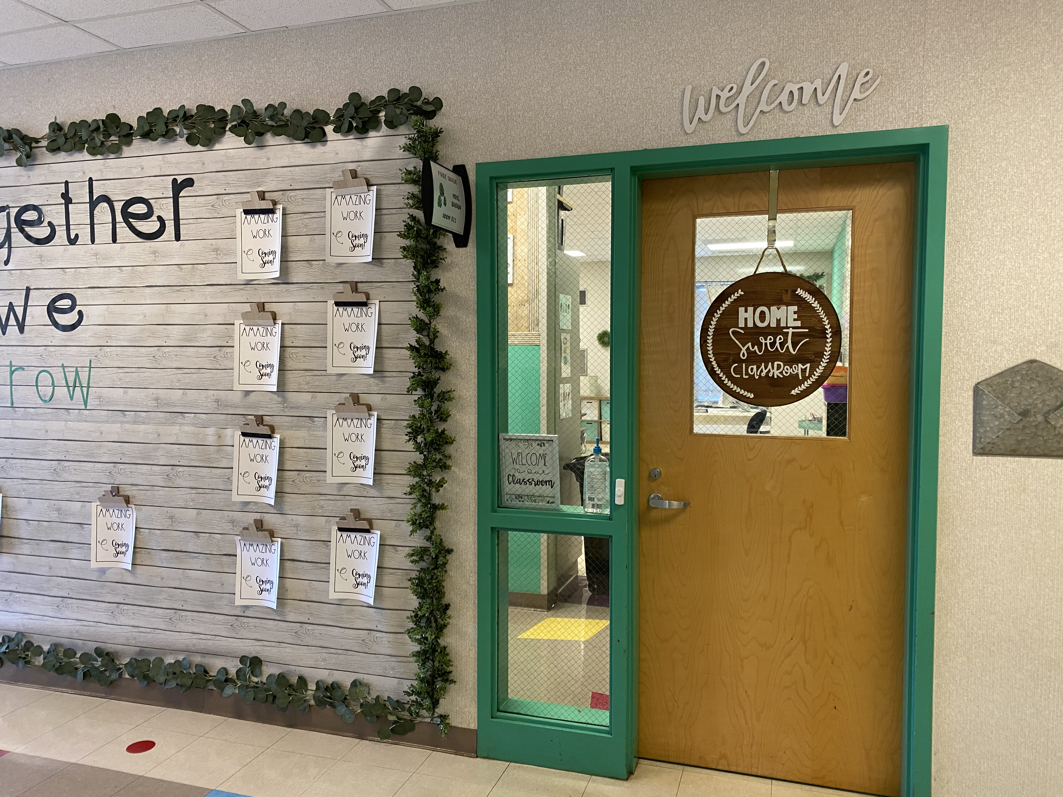
Welcome to Mrs. Brown’s First grade classroom

Slide 10
I will see you soon!

